Slide 1
UglierYOU
Perhaps the one time that ugliness is a good thing!

Slide 2
About us here at UglierYOU
Introduction
Purpose? “Defy the Conventional”
Why a website? Why not anything else?

Slide 3
User Interfaces
/Heuristics
Descriptive Buttons
Mostly One-Page Design
Big, Easily Viewable Photos
Designed for anybody

Slide 4
Problems We Faced
Issues with maintaining a one-page design
Lack of proficiencies at the start
Visions of the project
Time to meet

Slide 5
Technologies Used!
JS Libraries
Hard Work
Bootstrap
HTML5 & CSS3

Slide 6
Demo Personas

Slide 7
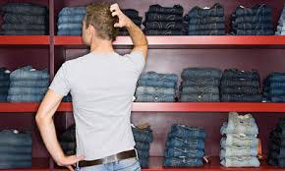
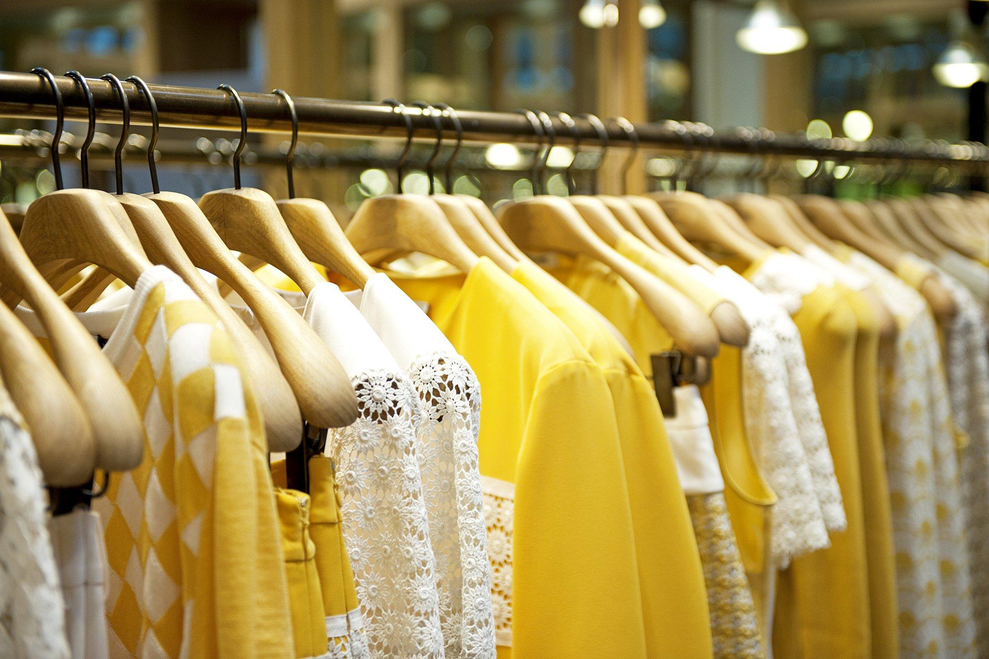
The Indecisive One
The “Show Me More” shopper

Slide 8
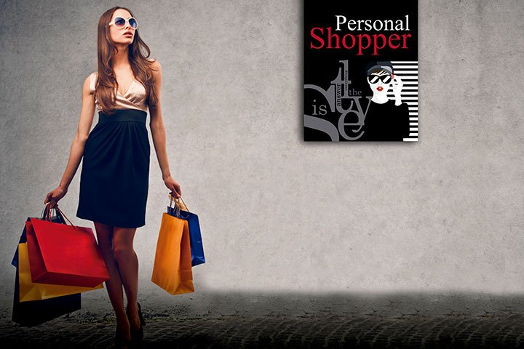
The Personalizer

Slide 9
Next Steps:

Slide 10
Thank you
Stay ugly, my friends. Stay ugly.

